Slide 1
Lightweight custom authentication with ASP.NET Core

Slide 2
ASP.NET Core Identity
ASP.NET Core Identity is popular choice when web application needs authentication.
It supports local accounts with username and password but also social ID-s like Facebook, Twitter, Microsoft Account etc.
But what if ASP.NET Core Identity is too much for us and we need something smaller?
What if requirements make it impossible to use it? Here’s my lightweight solution for custom authentication in ASP.NET Core.

Slide 3
ASP.NET Core Custom Authentication
We don’t have to use ASP.NET Core Identity always when we need authentication.
We are going to implement simple custom authentication which could be upgraded as much as needed in the future.
https://gunnarpeipman.com/aspnet-core-custom-authentication/

Slide 4
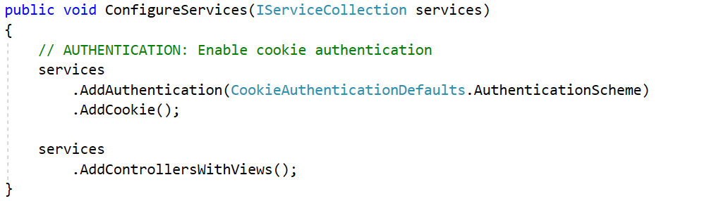
Configuring authentication

Slide 5
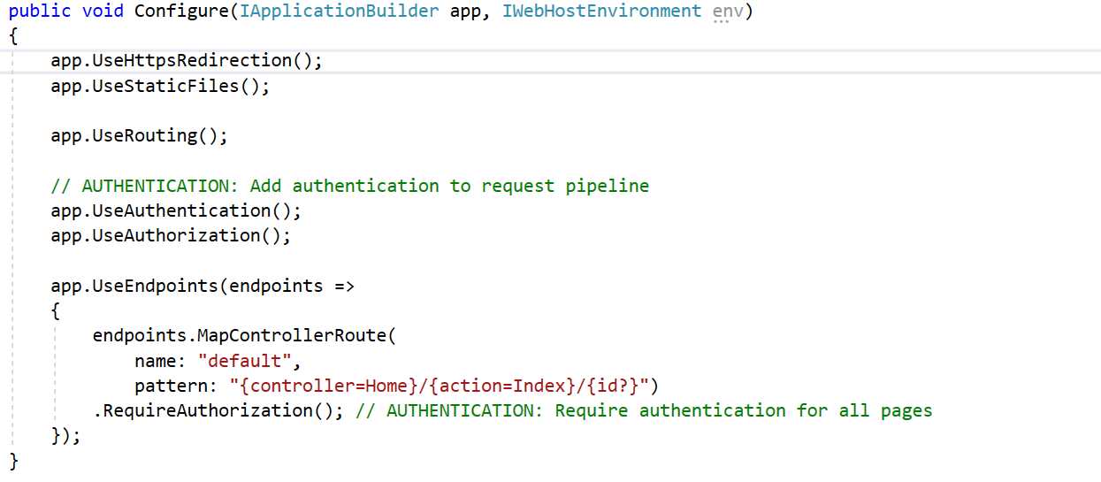
Add Authentication

Slide 6
Implementing AccountController
Where is user redirected when authentication is needed?
We didn’t say anything about it Startup class.
If we don’t specify anything then ASP.NET Core expects AccountController with AccessDenied and Login actions.
It’s bare minimum for our case.
As users must be able to log out I added also Logout() action.

Slide 7
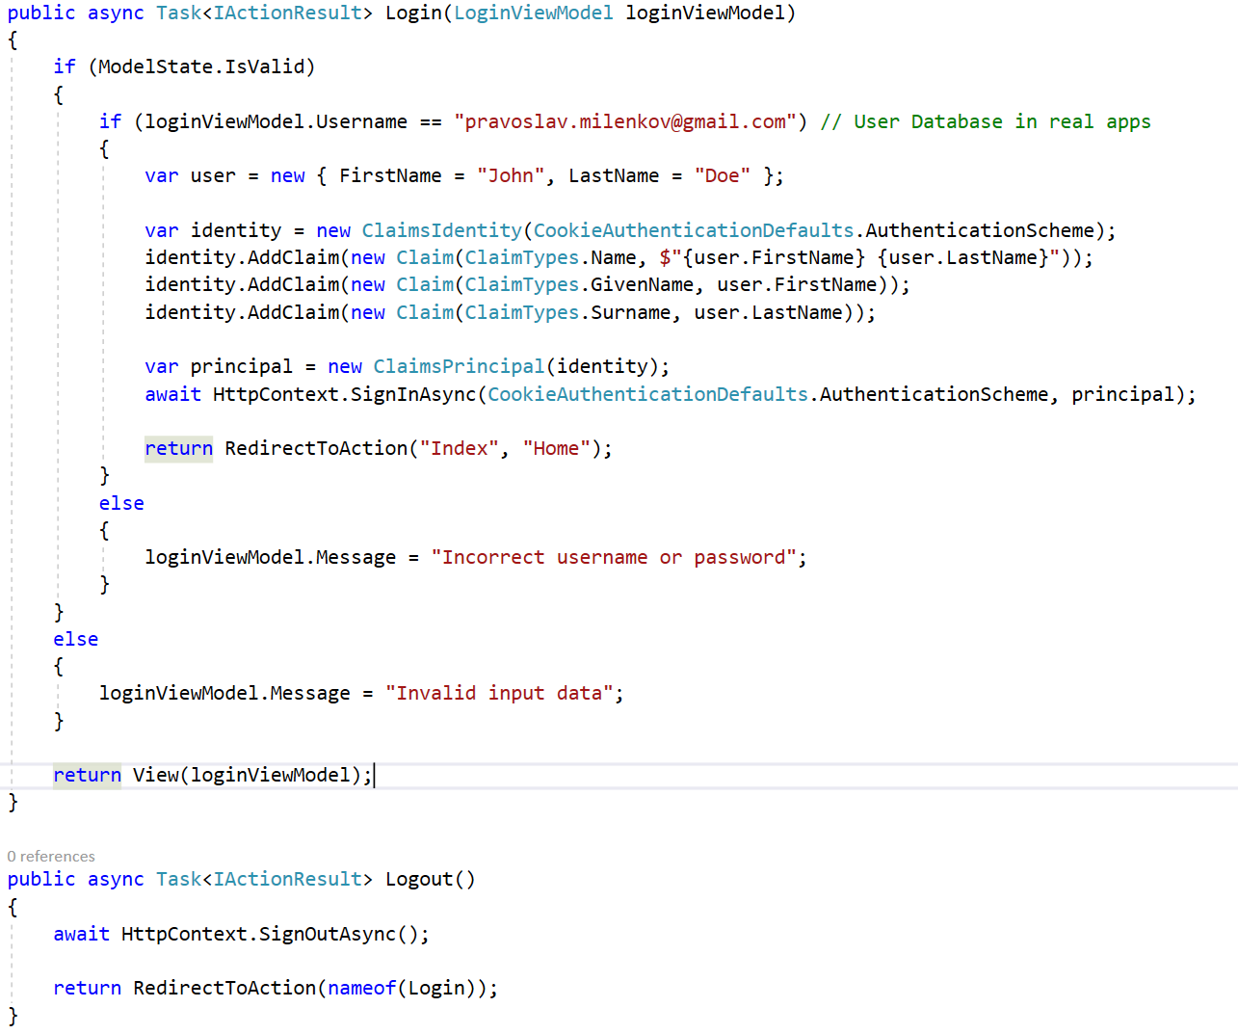
Implementing AccountController

Slide 8
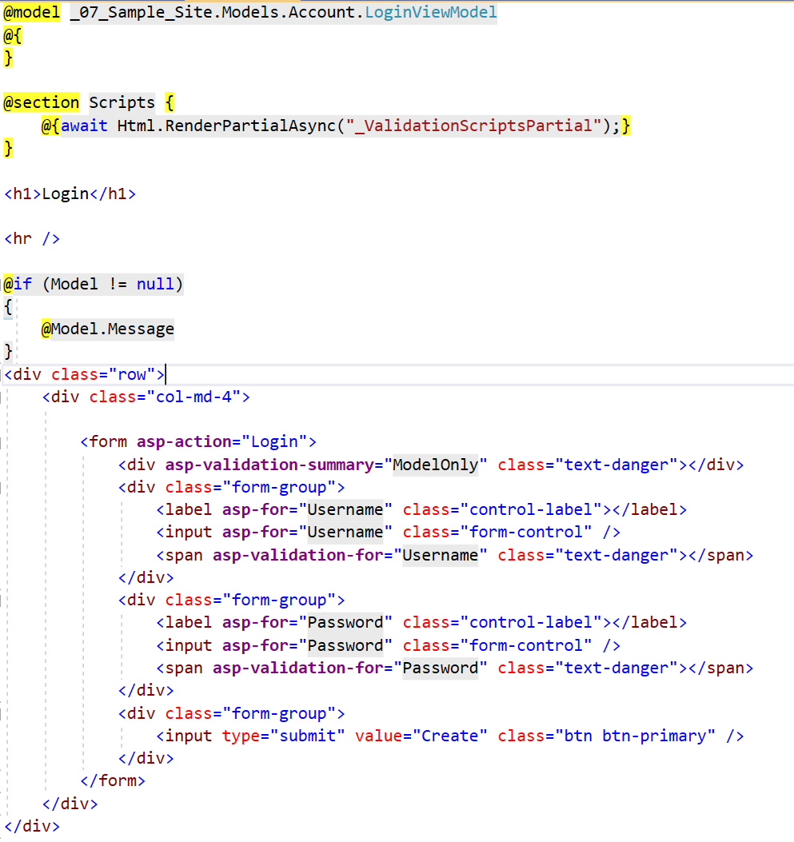
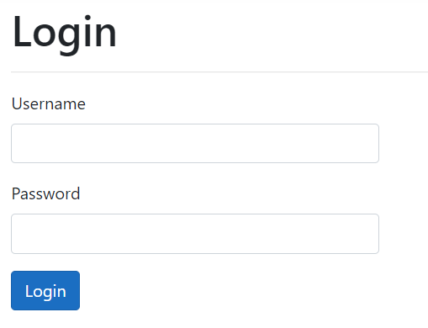
Login View

Slide 9
Homework – Simple Blog
Create a simple blog website
Implement free version of some bootstrap template(s)
Site should have administrative and public parts
Administrative part should be protected and allowed only for admin users
Public part should allow anonymous access
Admin panel should allow manage posts and categories
Public part should display list of all posts ordered by date and grouped by category
Public part should allow preview of entire post content

Slide 10
References
Authentication:
https://gunnarpeipman.com/aspnet-core-custom-authentication/
https://stackoverflow.com/questions/36095076/custom-authentication-in-asp-net-core
Front-end:
https://bootstrapmade.com/myportfolio-bootstrap-portfolio-website-template/
Back-end:
https://dashboardpack.com/bootstrap-templates/free-themes/
https://dashboardpack.com/live-demo-preview/?livedemo=290

